Slide 1
TI IIcDC 2018 Quarterfinals interim technical video
Team 390003: Automated Guidance System for Motor Vehicles

Slide 2
Product description :
Our product aims to curb the rising problem of motor vehicle accidents through the constant monitoring of the vehicles’ surroundings. Broadly our system addresses the following issues :
Internal monitoring focuses on ensuring the driver is fit to drive
Externally, we intend to provide 360 degree analysis
Warnings of incoming traffic (including pedestrians) in the blind spots
Minimum braking distance (depending on road conditions and speed)
Guides a vehicle steering off course back on the road.

Slide 3
Product layout :
Technical Components :
Beagle Bone Black (Texas Instruments BBONE-BLACK-4G )
128x128 LCD Screen (Texas Instruments BOOSTXL-SHARP128)
Texas Instruments TMDSEVM572x Camera Module
Micro Speakers
REES52 REES-1397 Single-Point TFmini Micro Ranging Lidar
REES52 Ultrasonic Range Finder Module Sensor

Slide 4
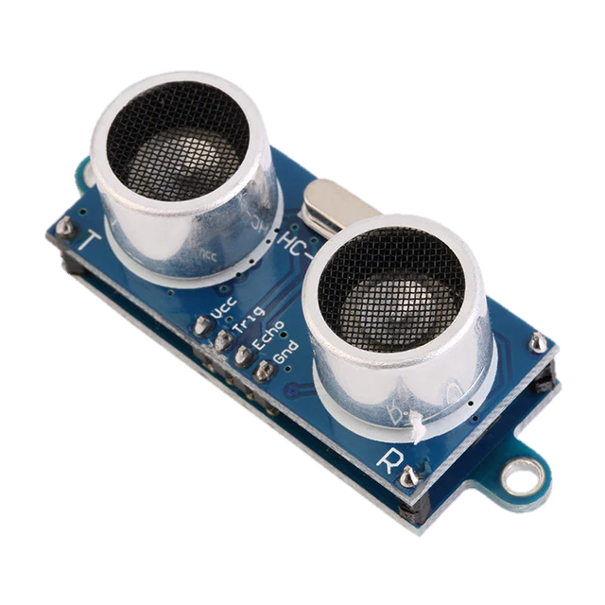
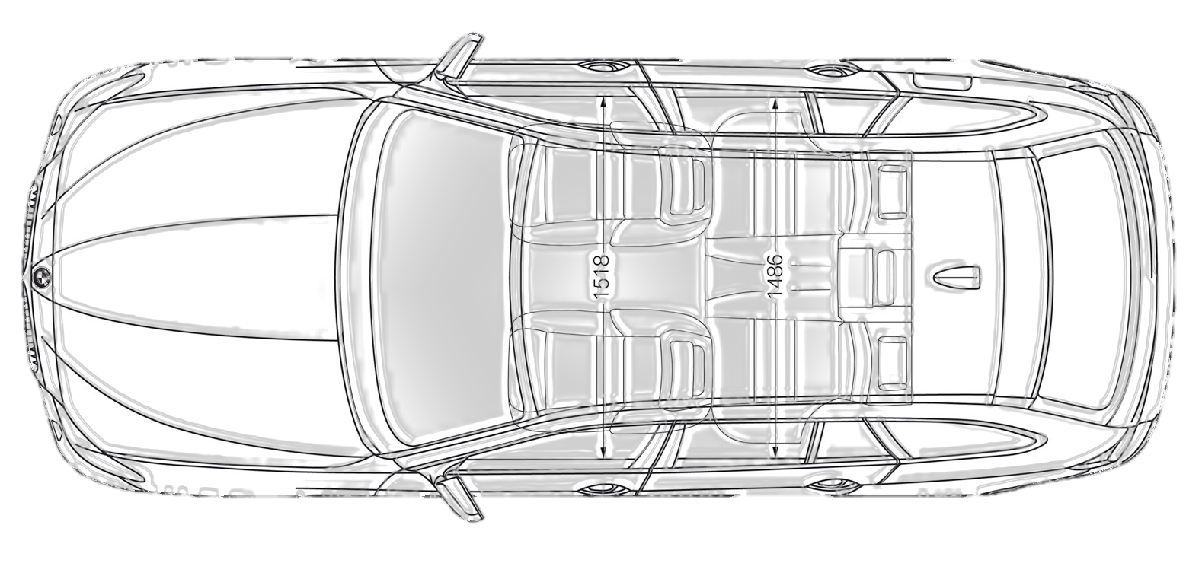
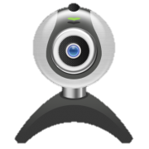
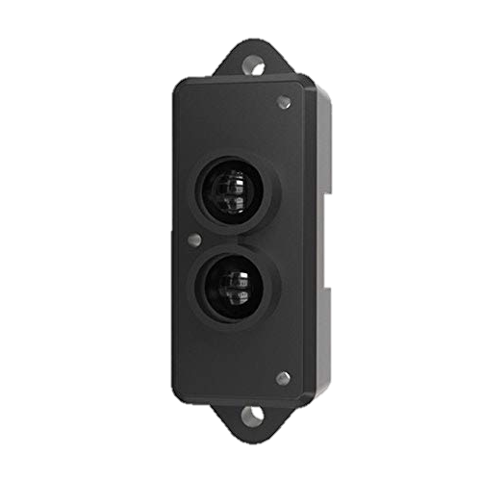
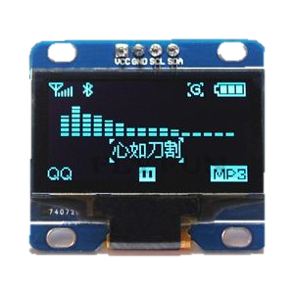

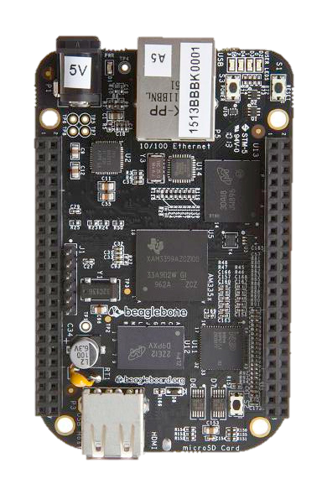

Ultrasonic Sensor
Camera
Lidar Sensor
LCD Screen
Micro Speakers
Beagle Bone Black
Ultrasonic Sensor

Slide 5
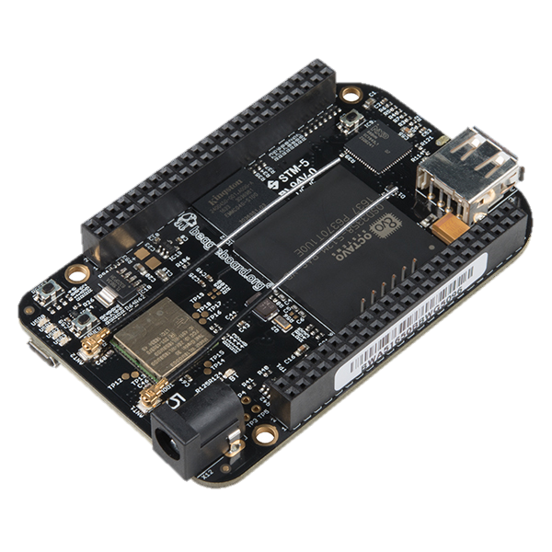
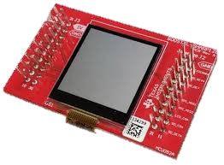
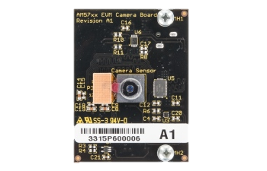
Usage of Parts :
Beagle Bone Black (Texas Instruments BBONE-BLACK-4G )
Used for data processing
Low Cost and Community Supported
Highly Efficient
Texas Instruments BOOSTXL-SHARP128
High Contrast LCD Screen
Used to display warnings and other information to the user
Texas Instruments TMDSEVM572x Camera Module
1 Mega Pixel Camera Module
Used by Machine Learning Algorithm to assess driver attentivenes

Slide 6
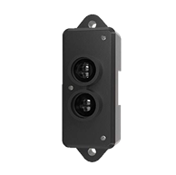
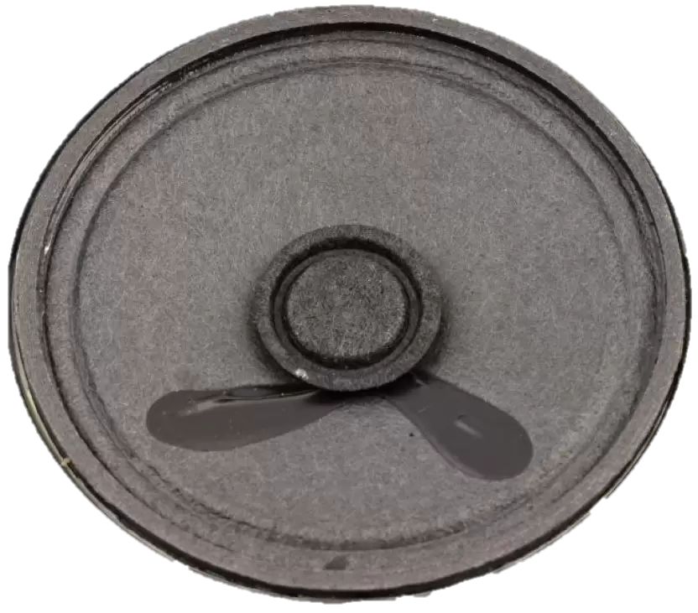
REES52 REES-1397 Single-Point TFmini Micro Ranging Lidar
Used for Car/Traffic Detection
Light weight and efficient
Operating range of 0.3m to 12 m (ideally suited for urban users)
REES52 Ultrasonic Range Finder Module Sensor x 2
High Precision (upto 2mm)
Optimum Range
Cost Efficient
Micro Speakers

